Slide 1
Xgenplus Front End App
Android & iPhone App
Users can access email through Android & iPhone

Slide 2

Xgenplus Android App
Bharatsync Communicator

Slide 3
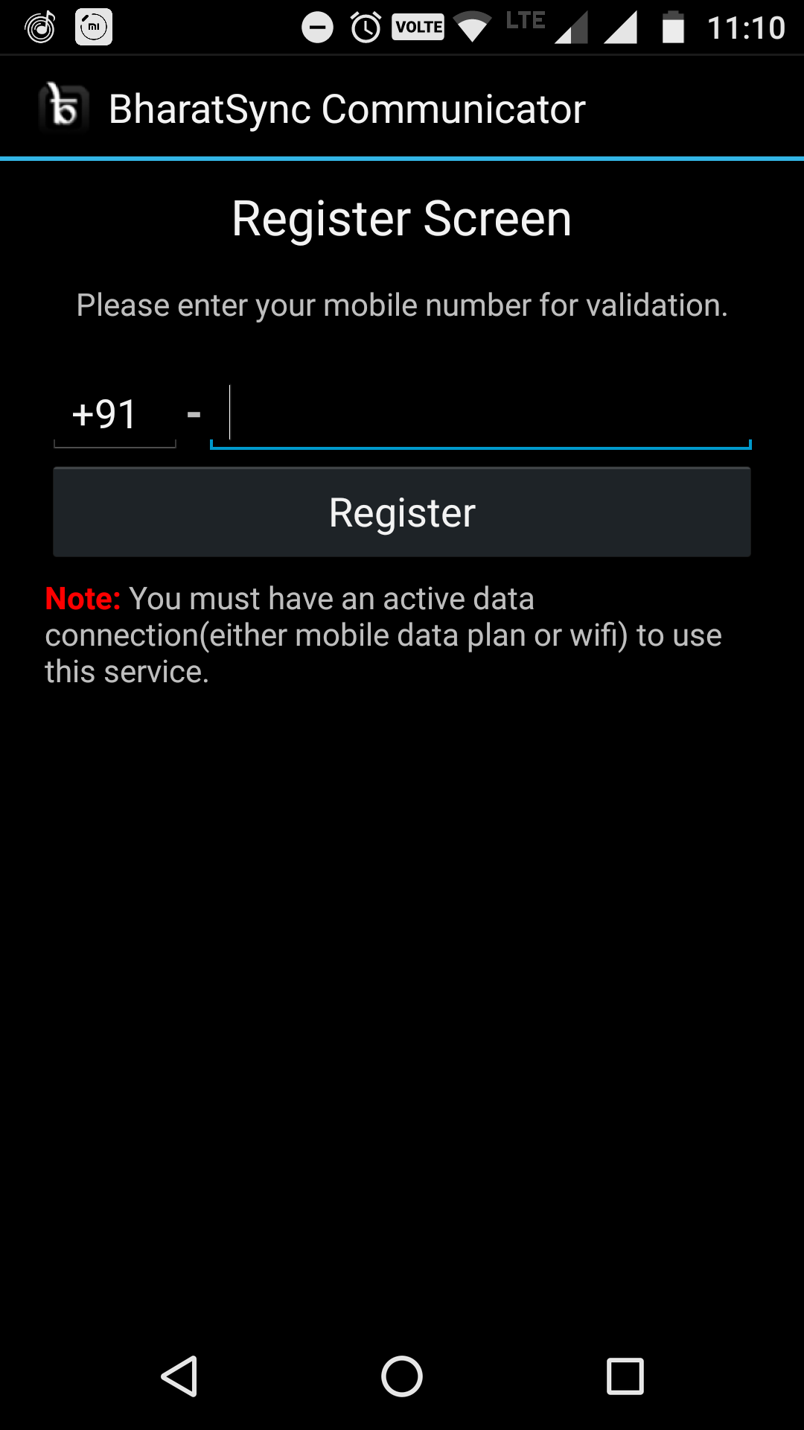
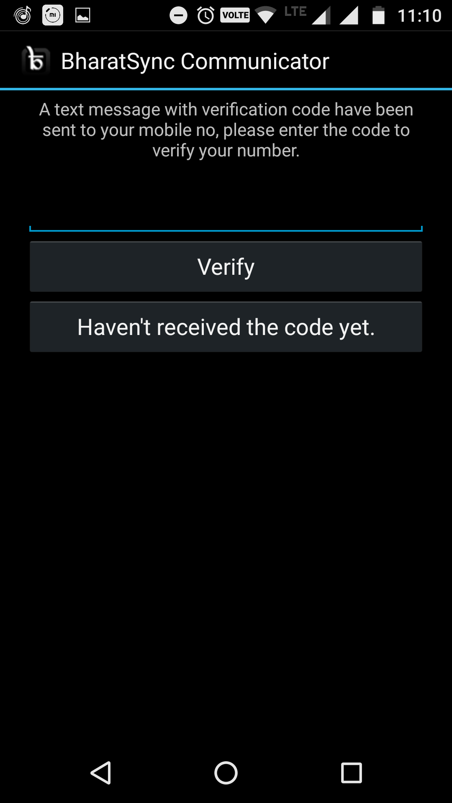
Once user download application , user will get Register screen where they need to register their mobile number
After registration number will be verified through OTP

Slide 4
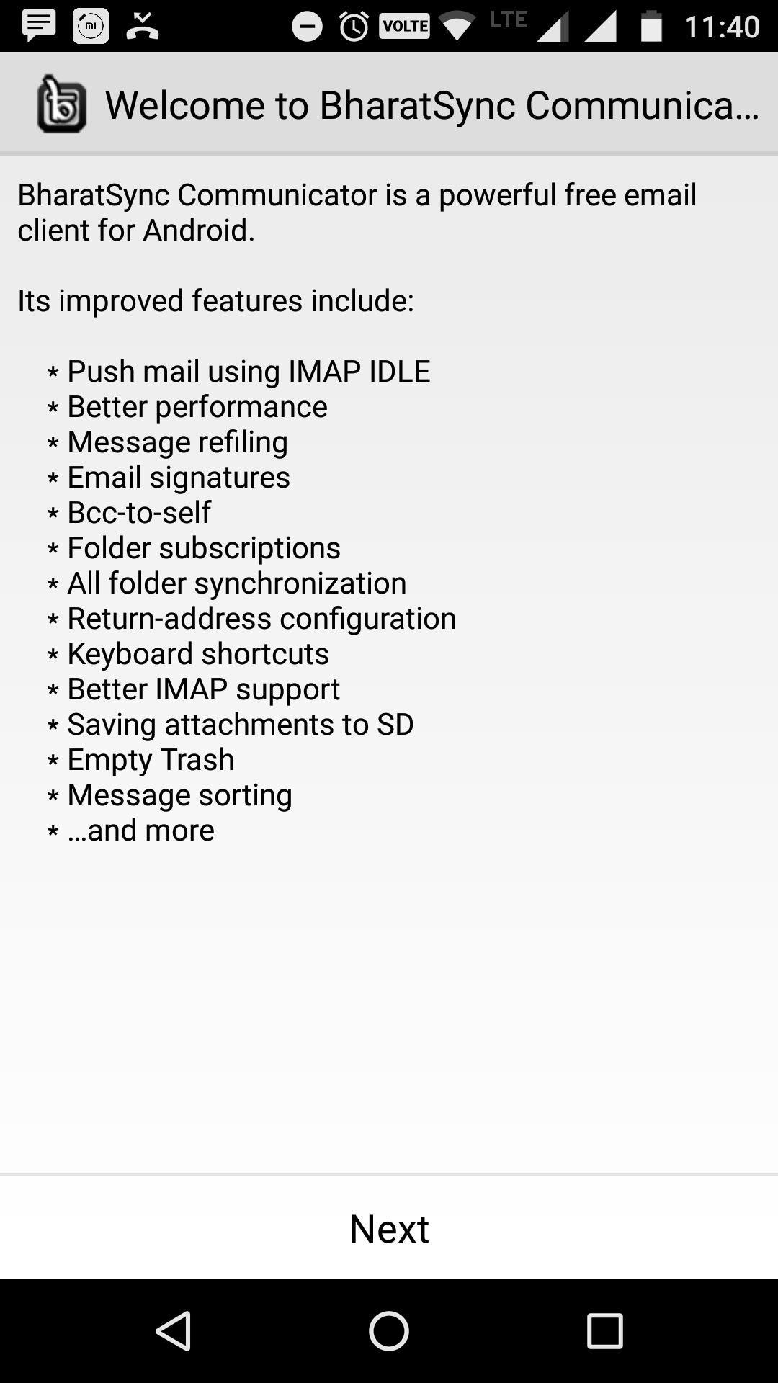
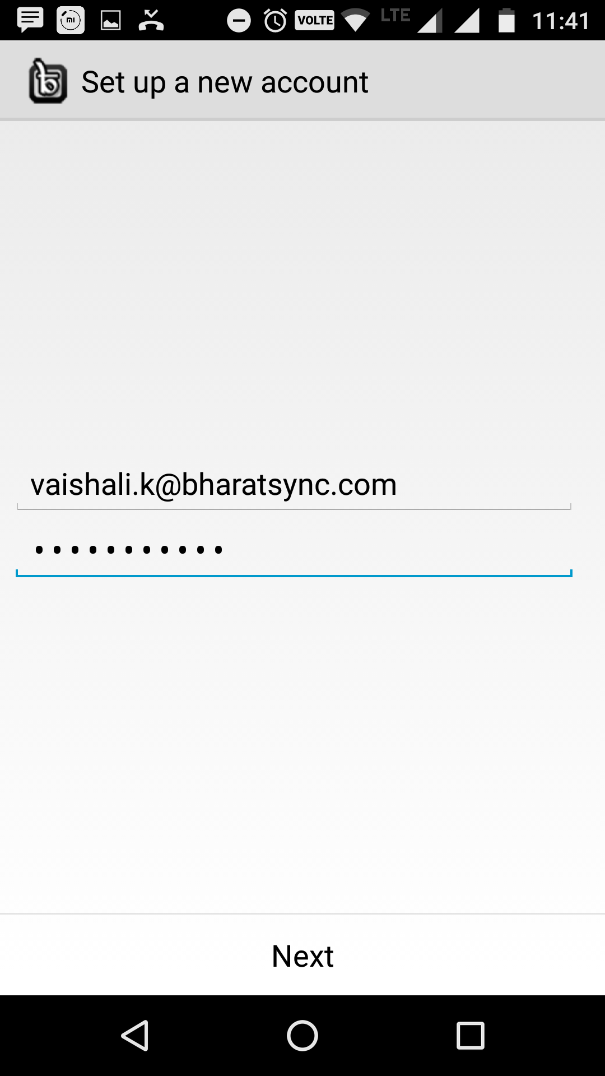
After number verification user will be redirect over Welcome Screen
Once user select NEXT, they will get screen through which they can set their email account

Slide 5
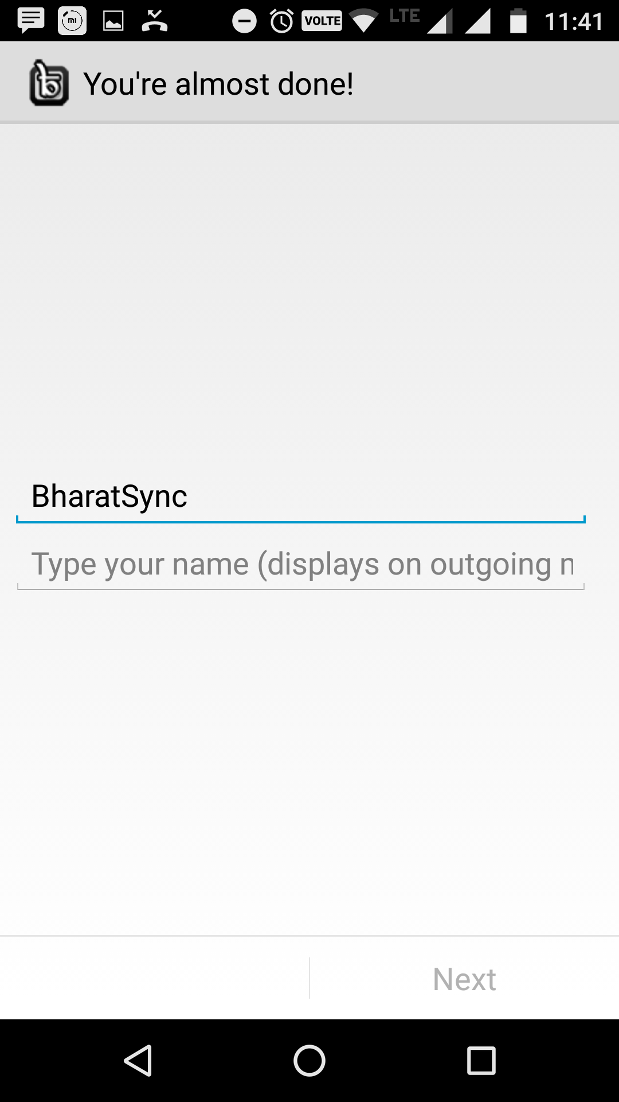
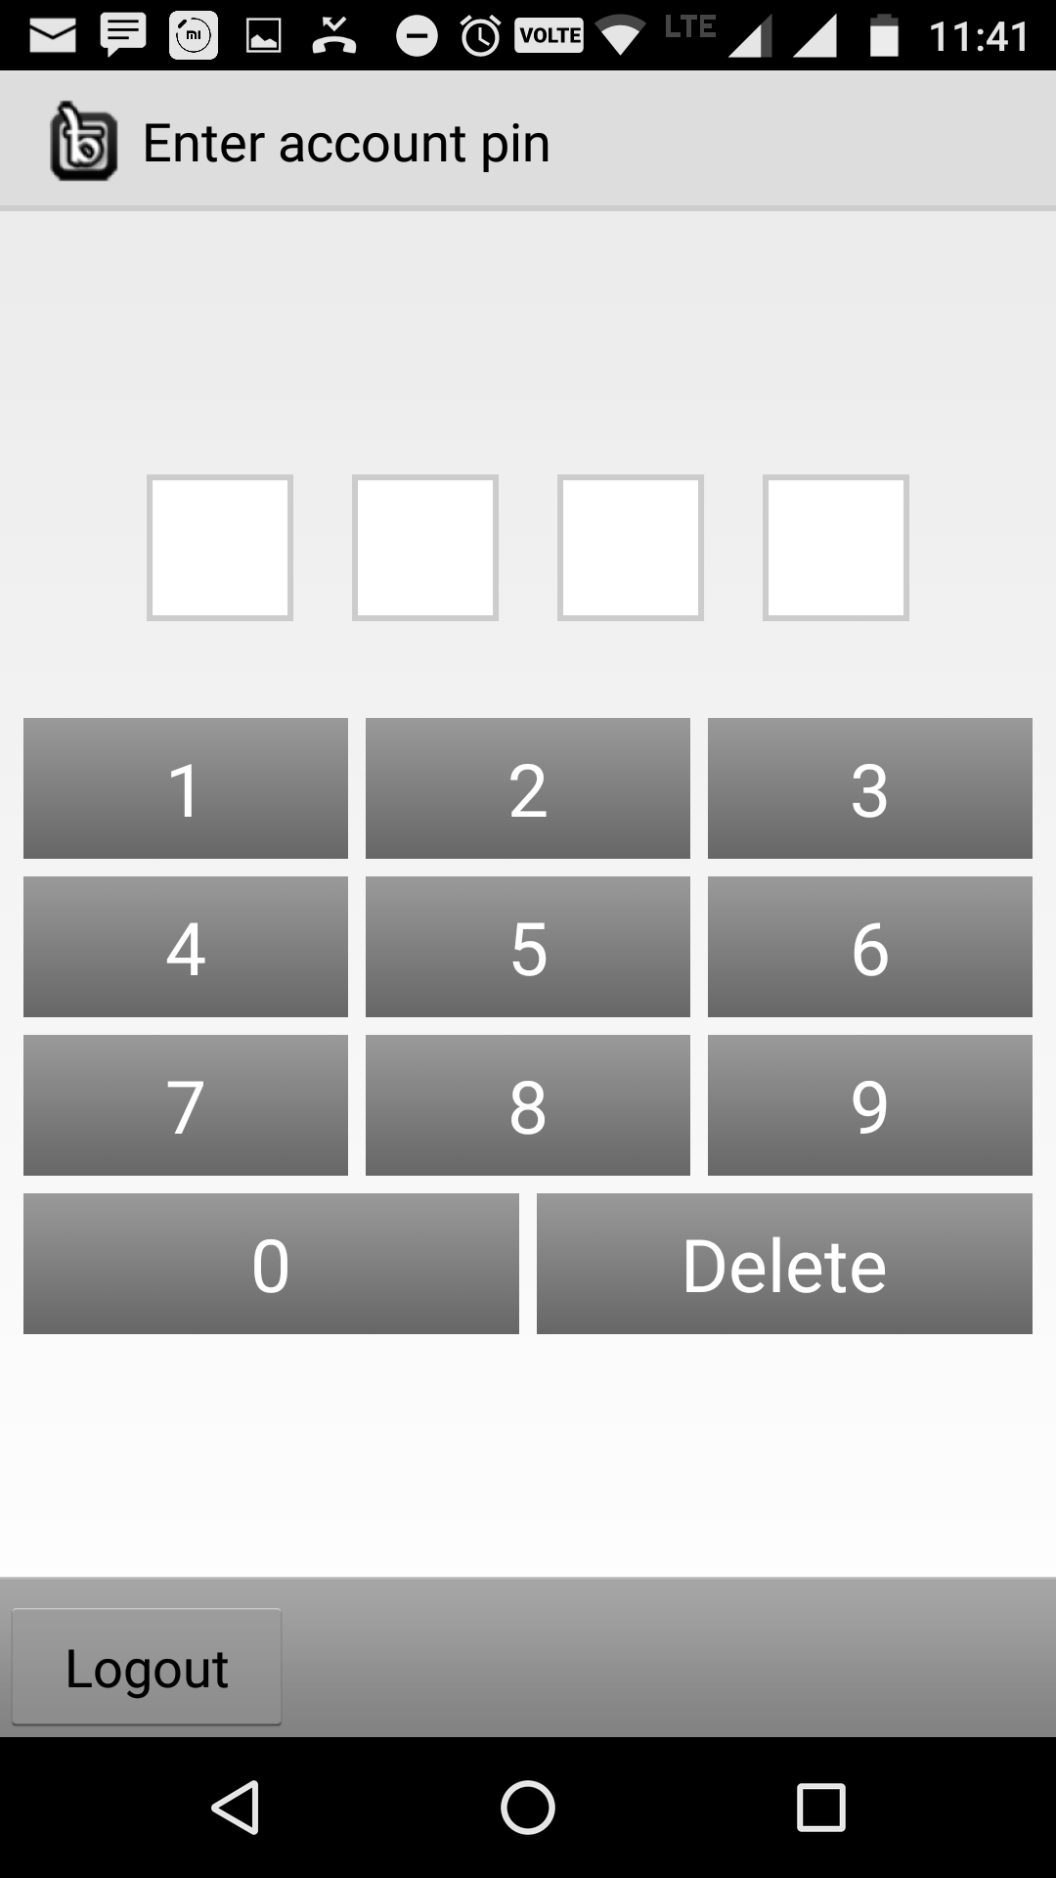
Now user can type its Display Name
User have to set a pin through user will access its account everytime.

Slide 6
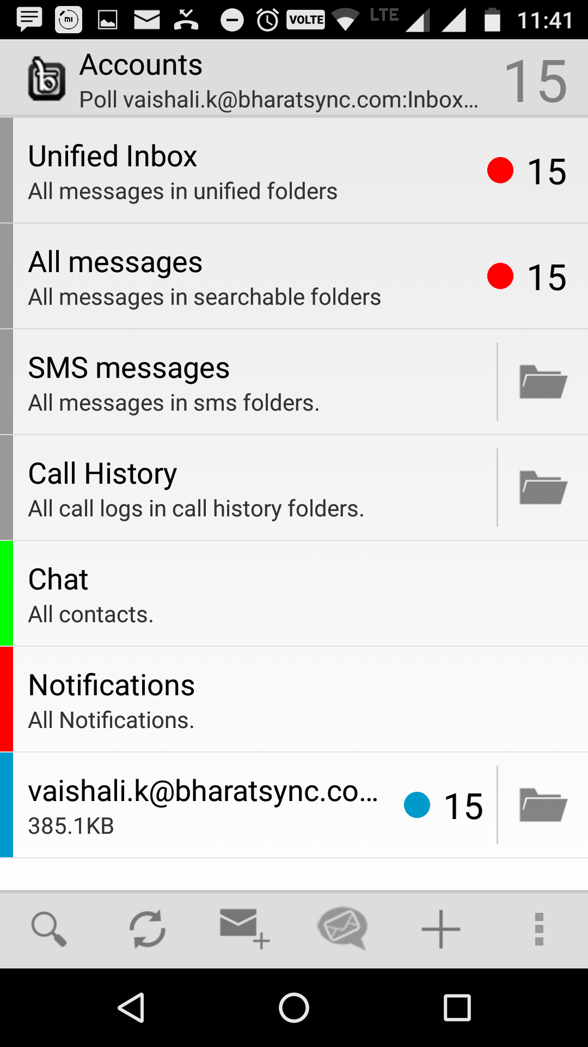
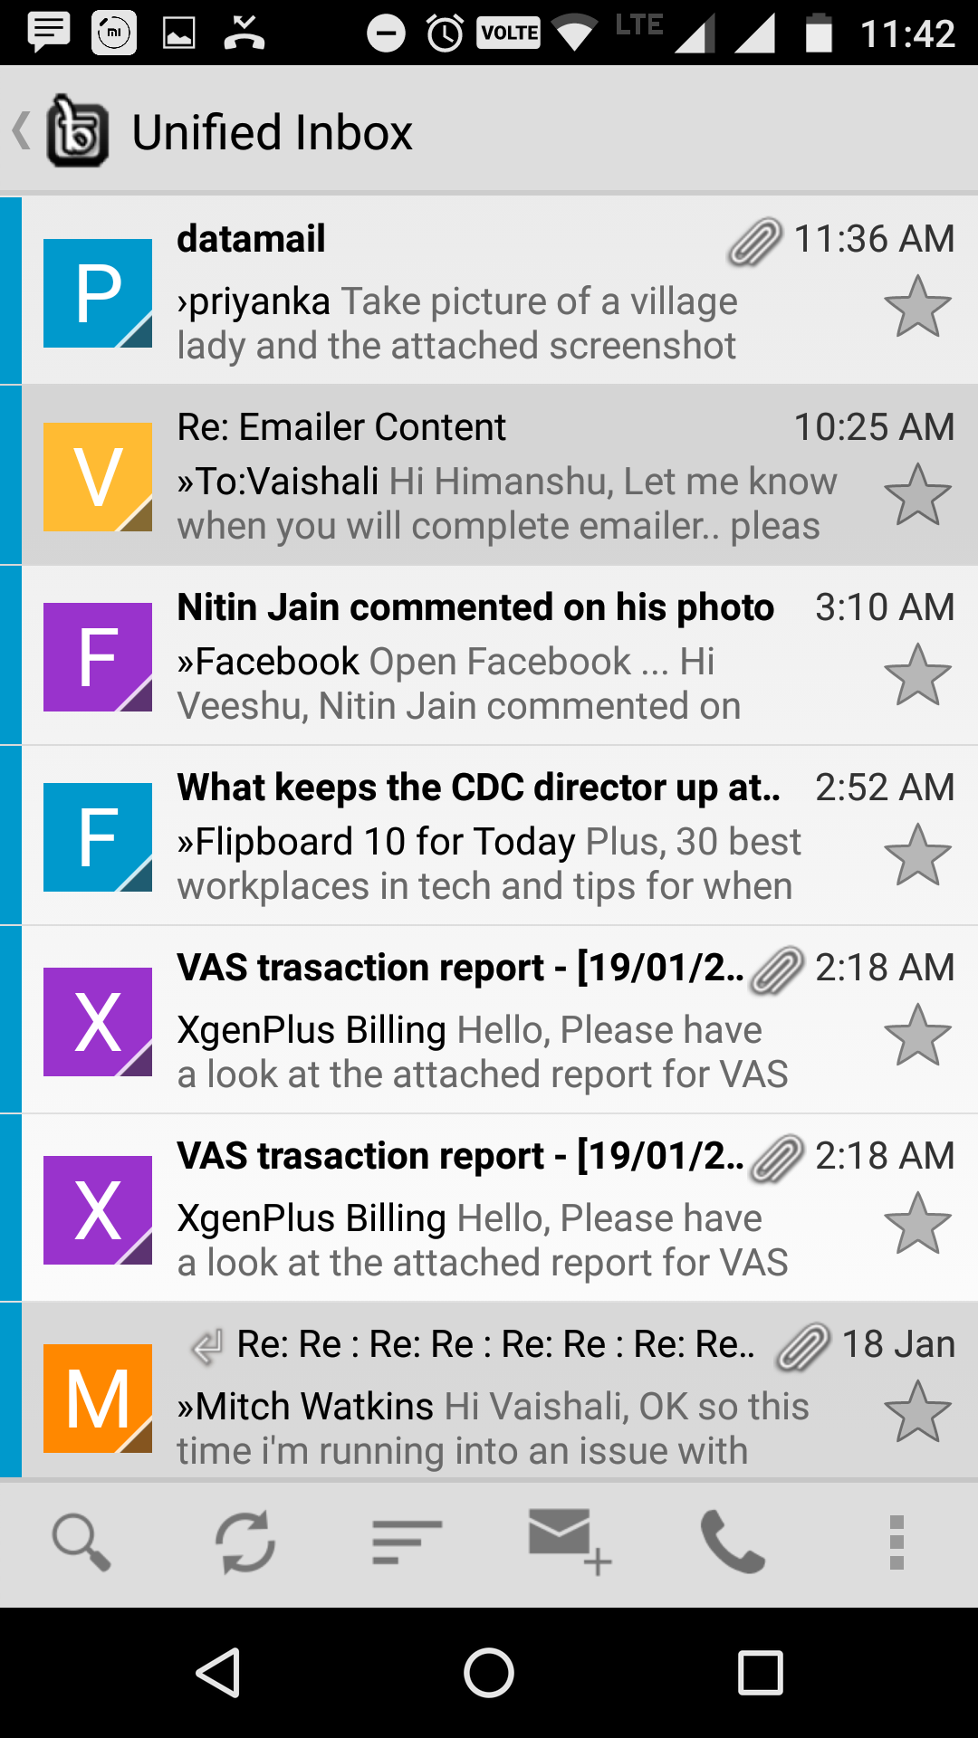
After Reconfirmation of PIN user will get Dashboard, where user can find all the folders and EMails
User can check INBOX and its emails

Slide 7
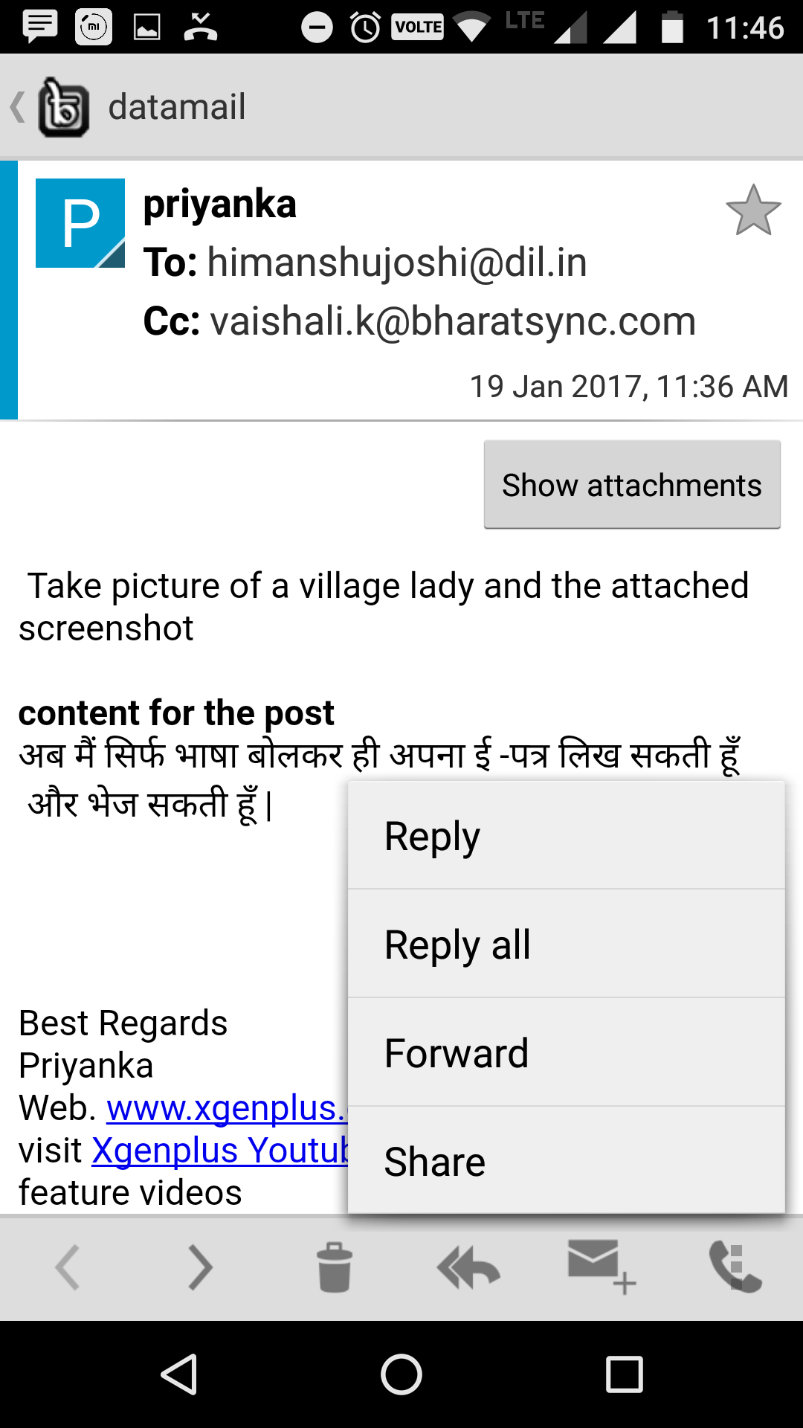
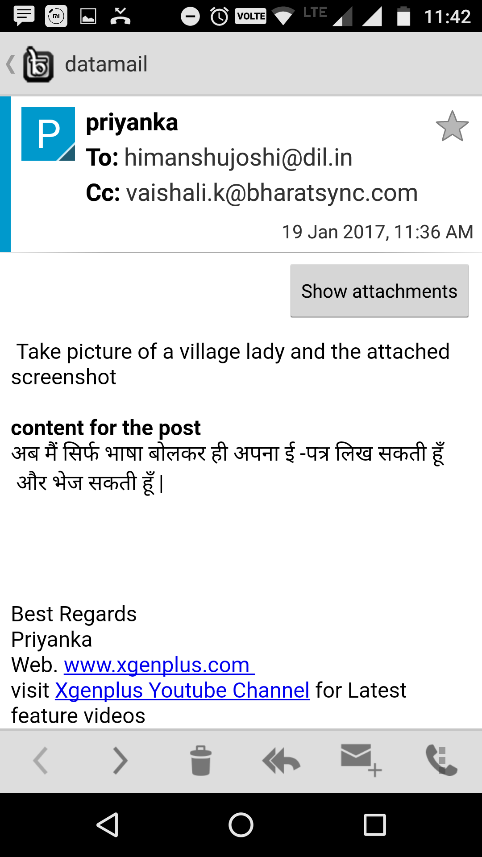
User can browse specific Email
User can Reply for this email as well

Slide 8
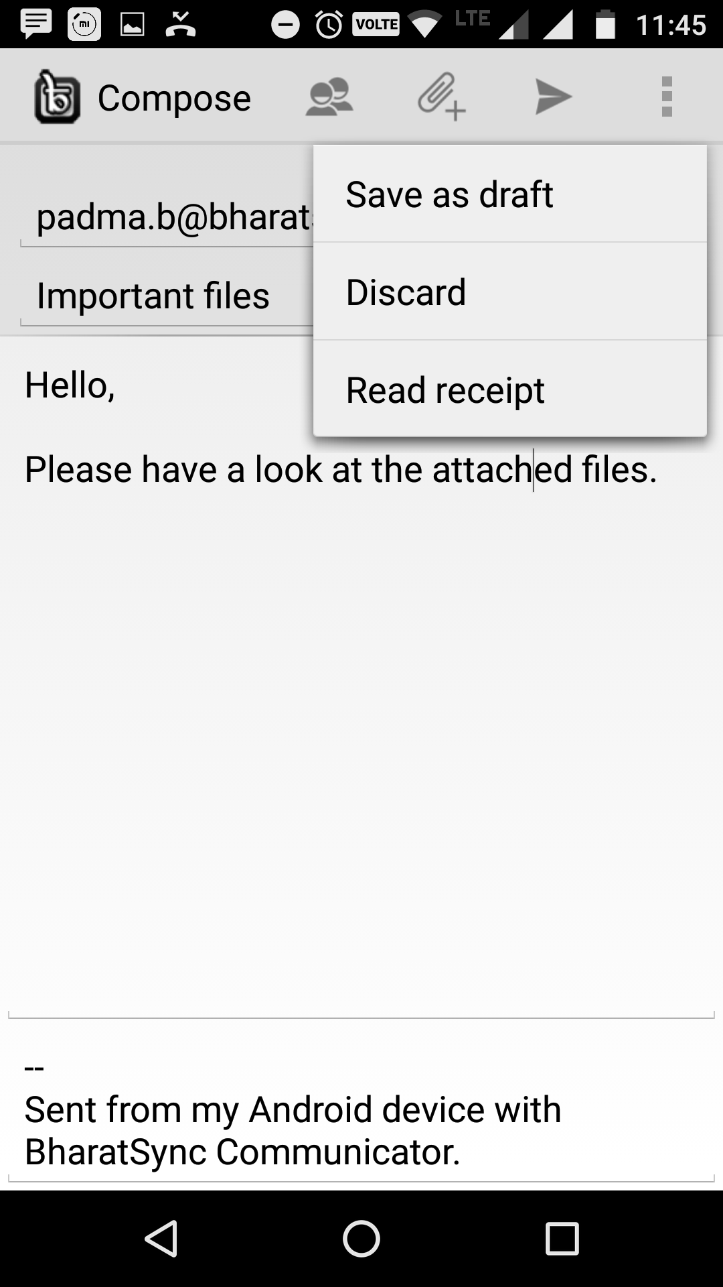
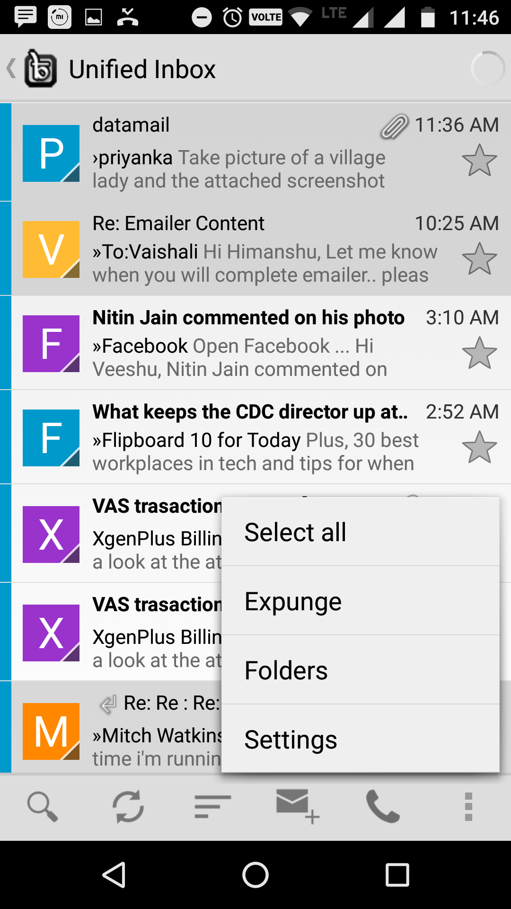
User can browse different options like Settings, Compose Email, Search, Filter
User can COMPOSE Email through Compose option

Slide 9
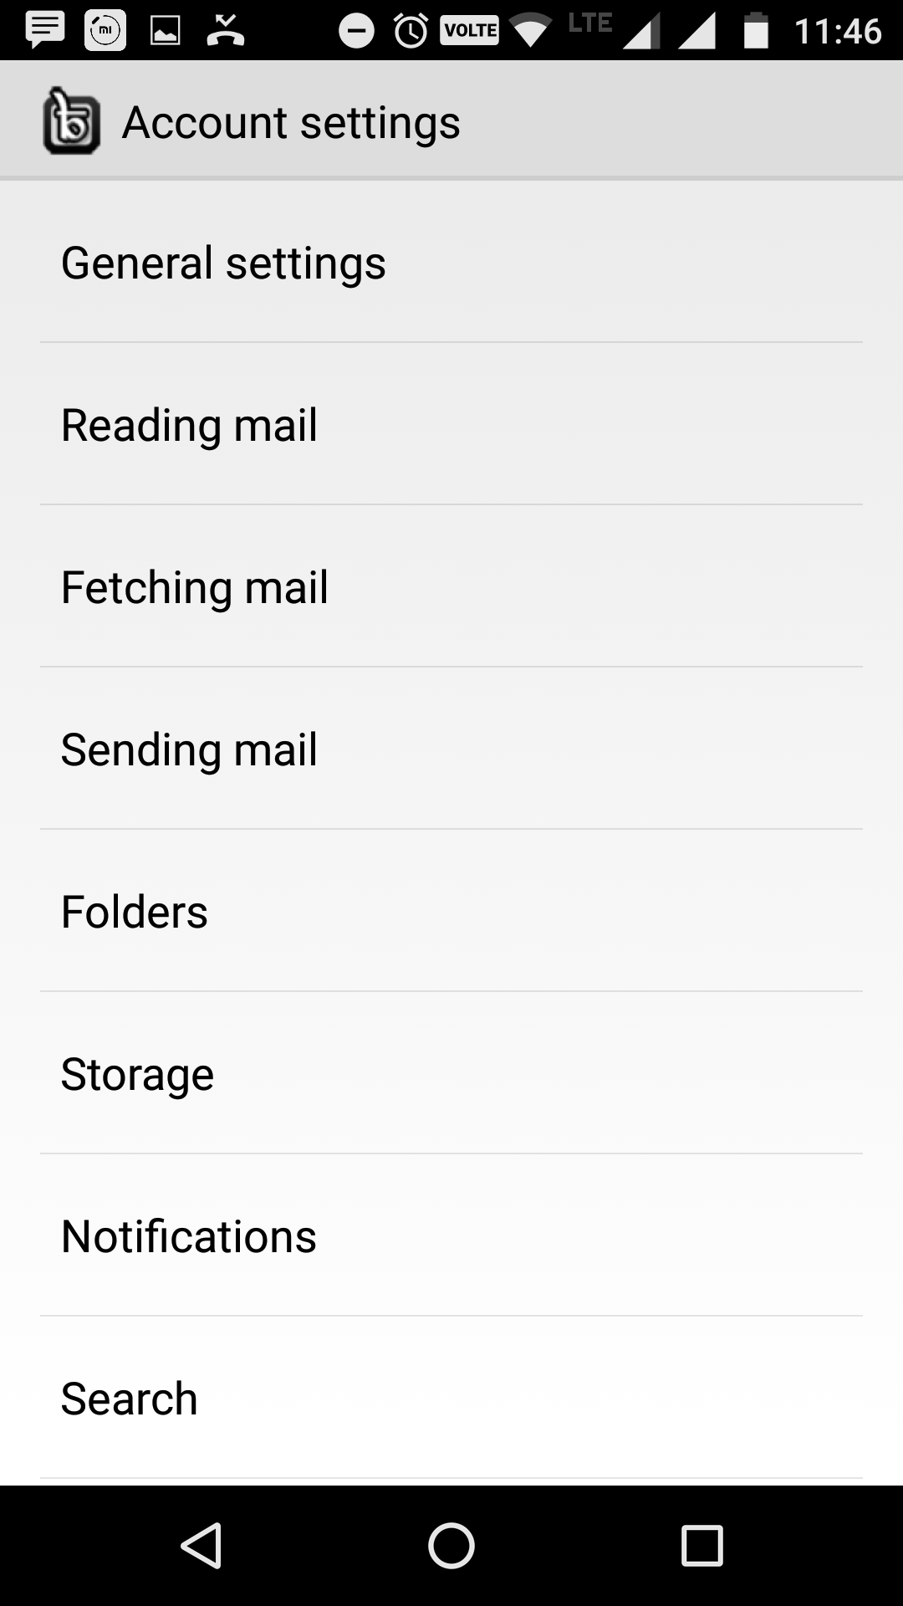
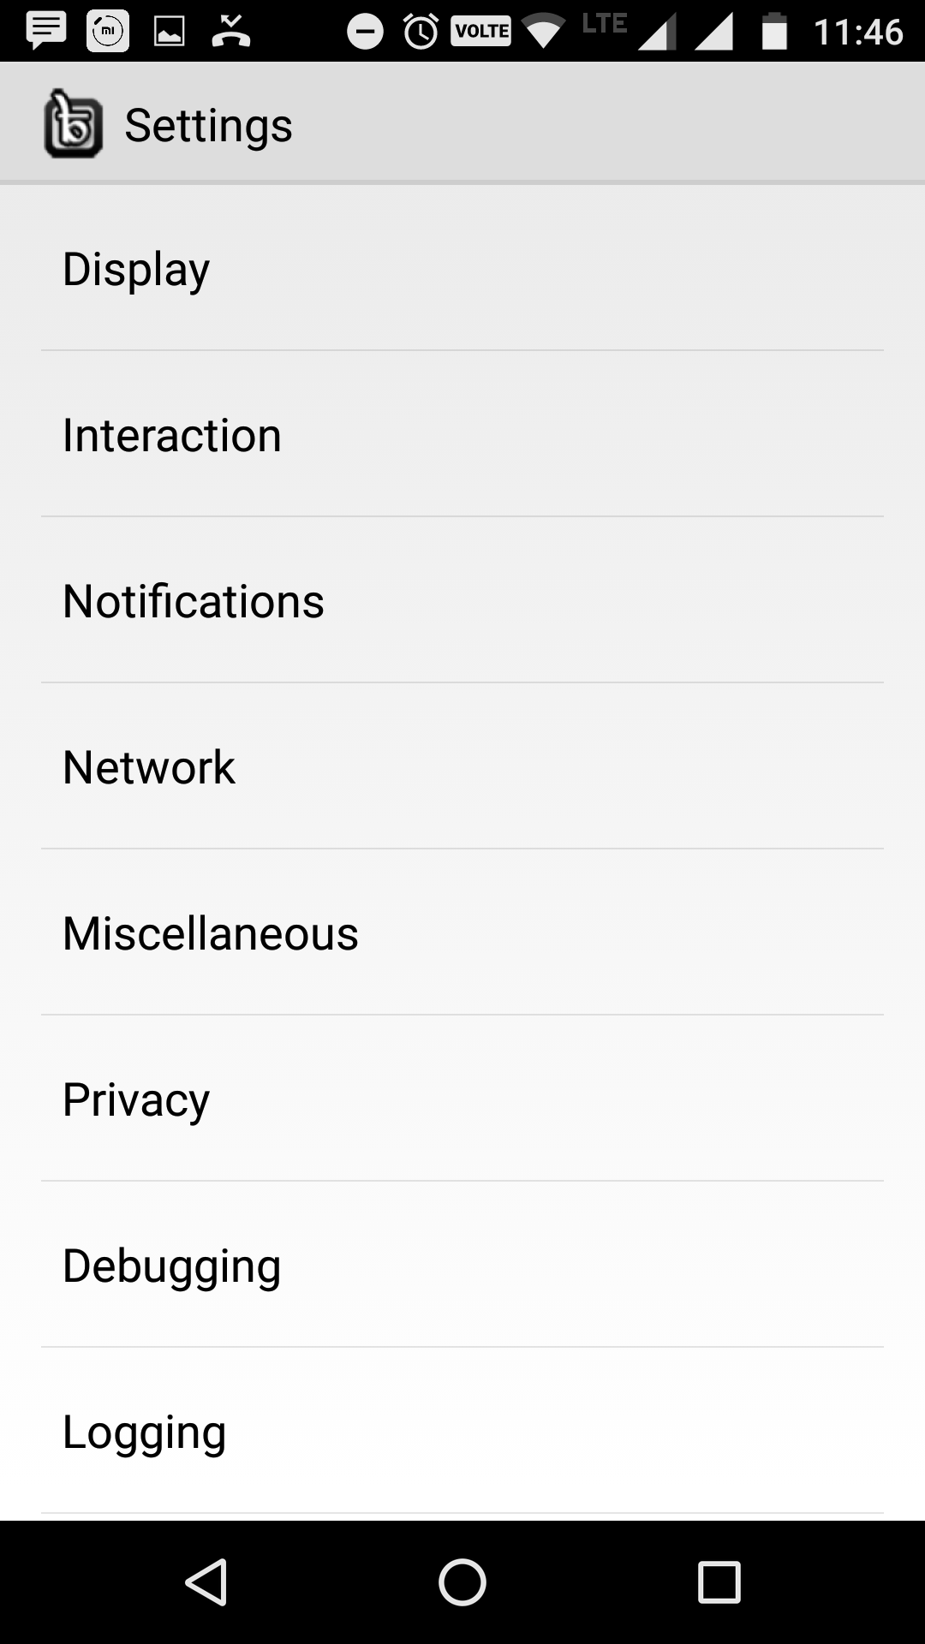
With SETTING Option, user will get 2 types of settings: Account Setting
General Setting

Slide 10
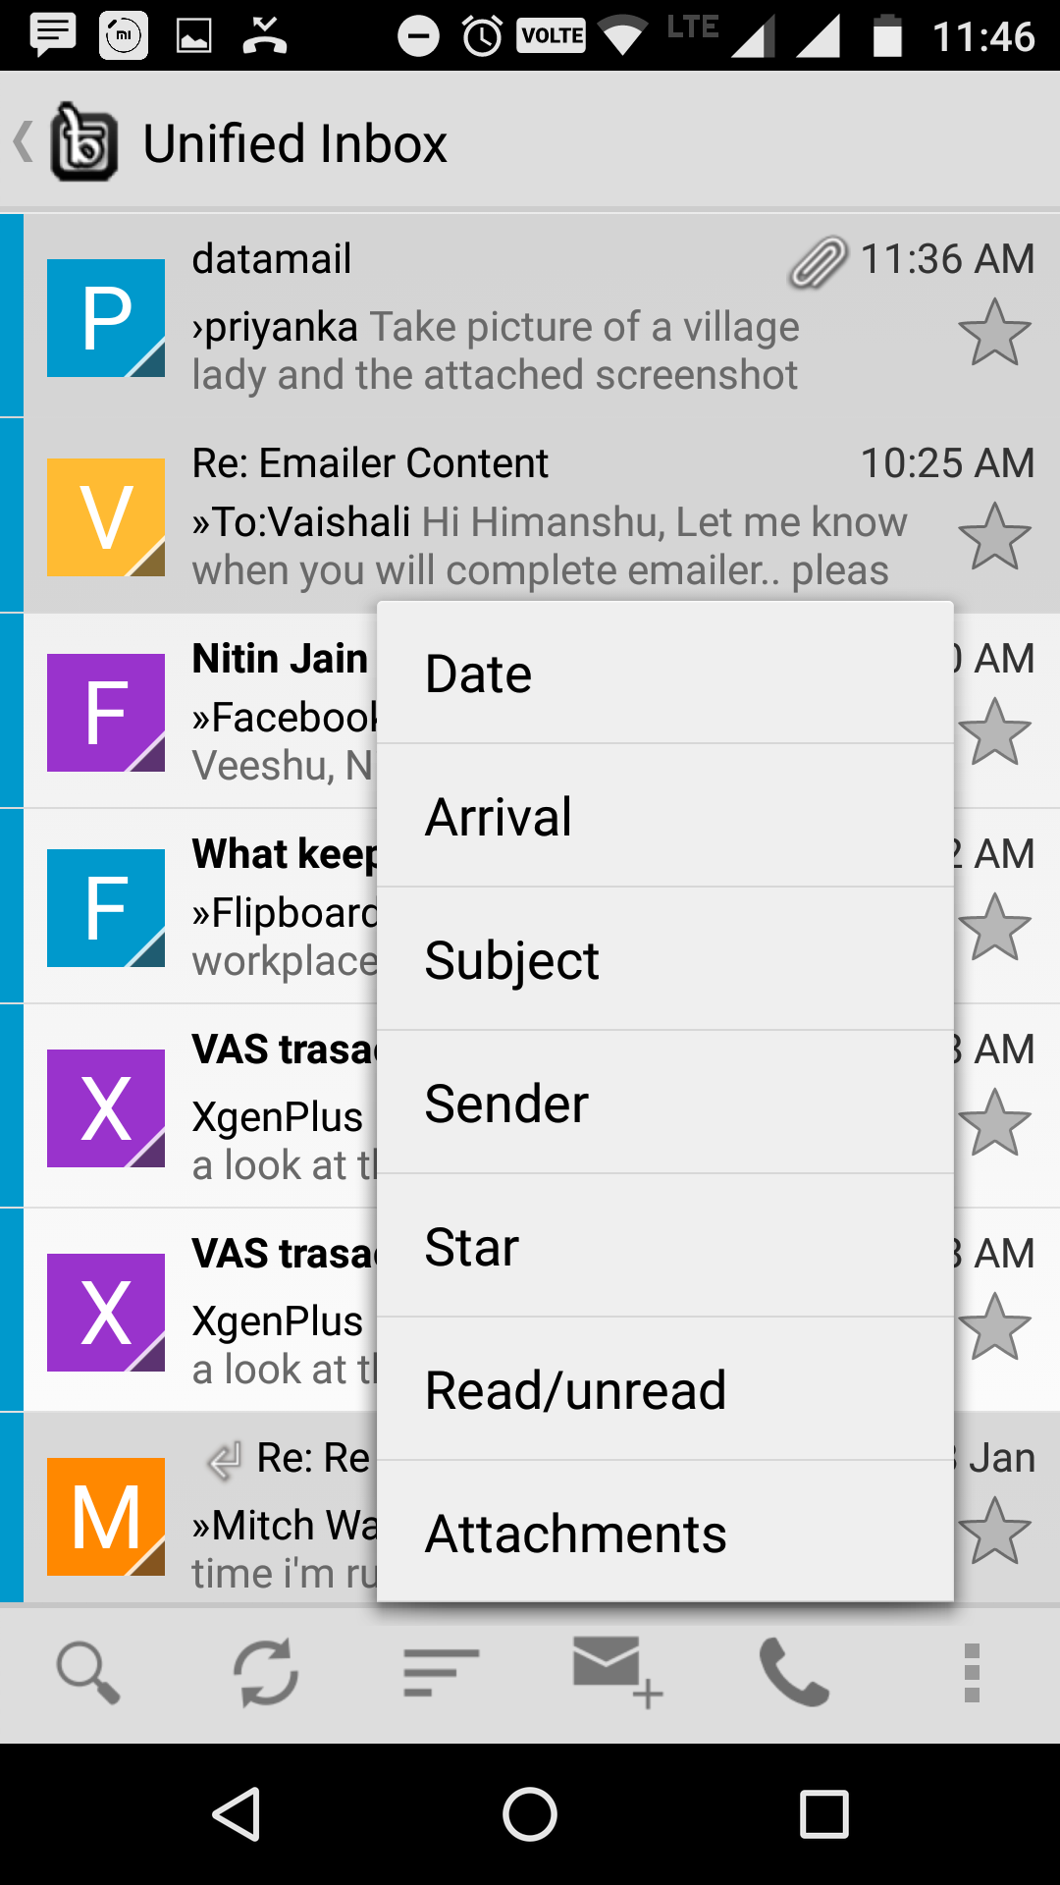
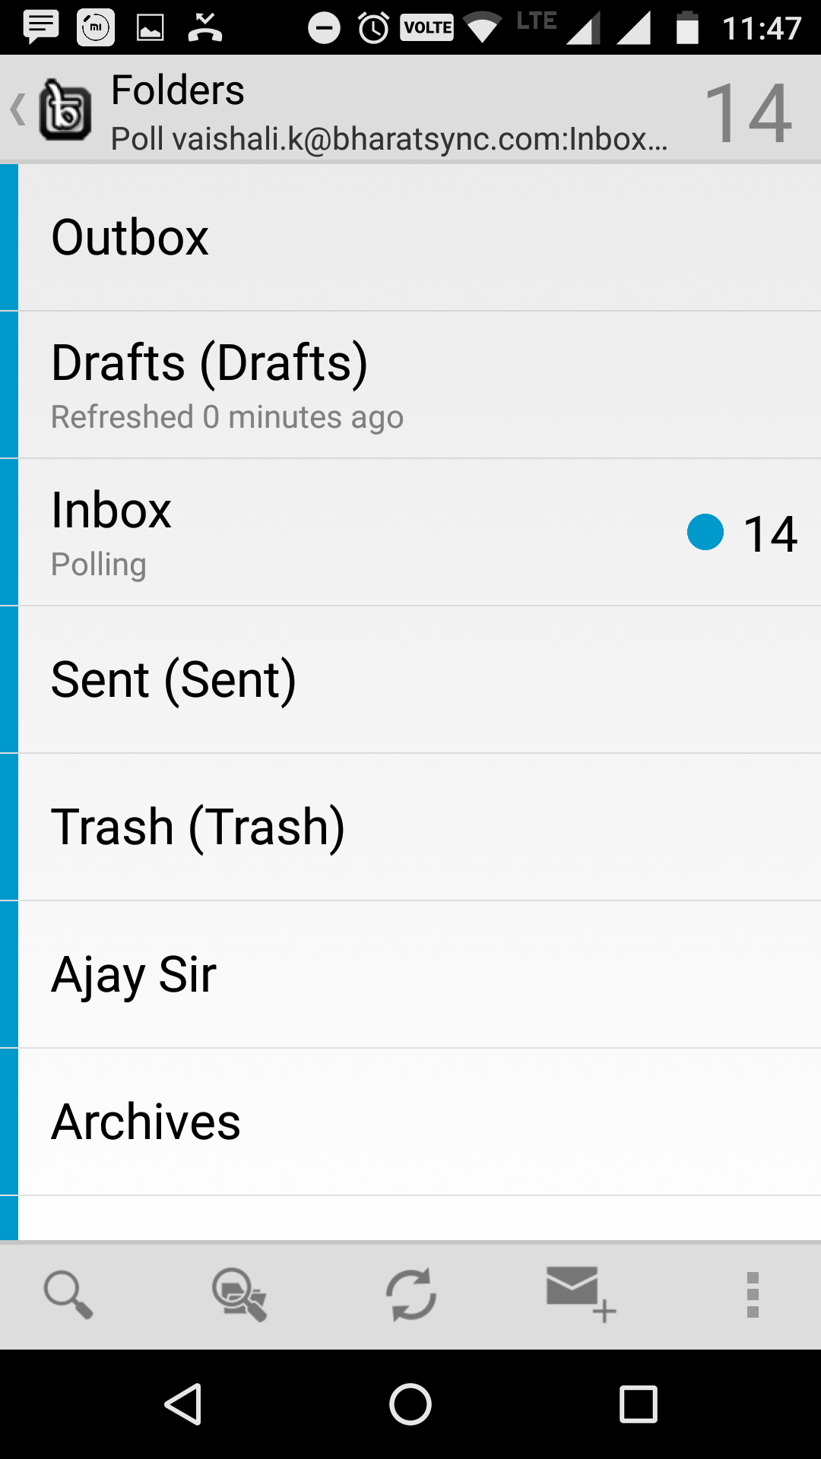
User can FILTER Emails with different Options
Users will have access of different Folders

Slide 11
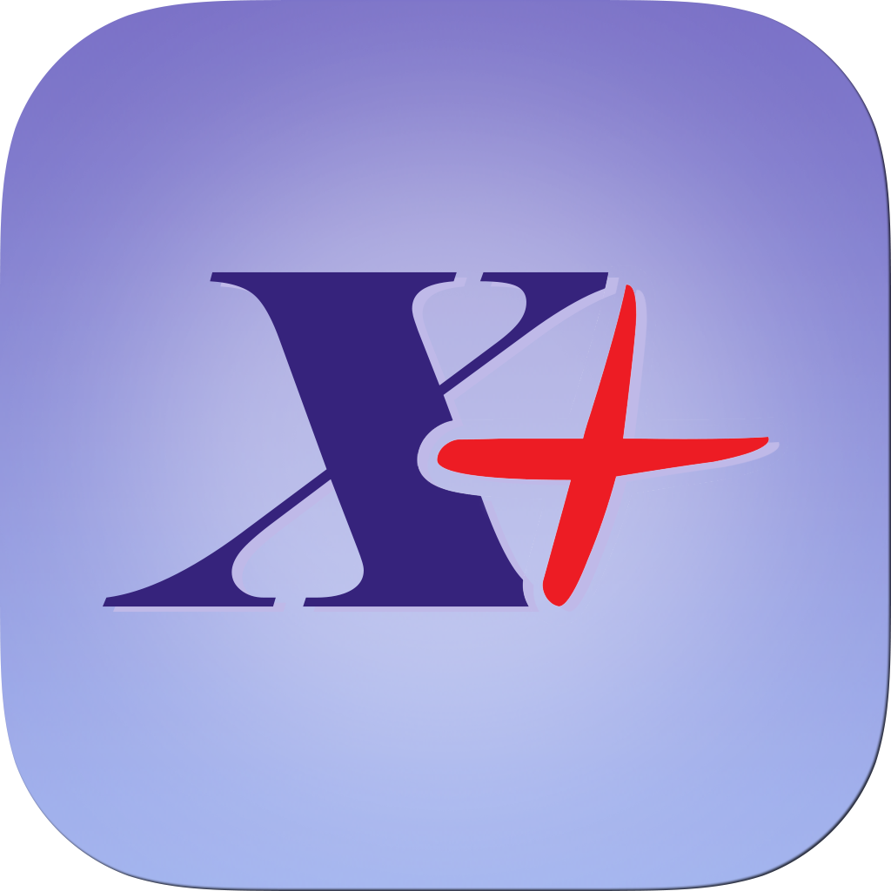
Xgenplus iPhone App
XgenMailApp

Slide 12

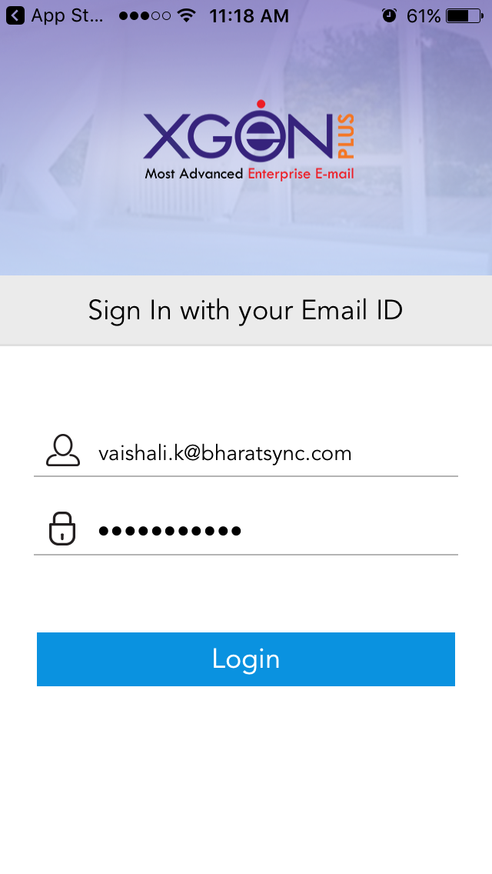
Once user will download Xgenmailapp through iTunes, will get Splash Screen
Now App will ask for Email ID & Password

Slide 13
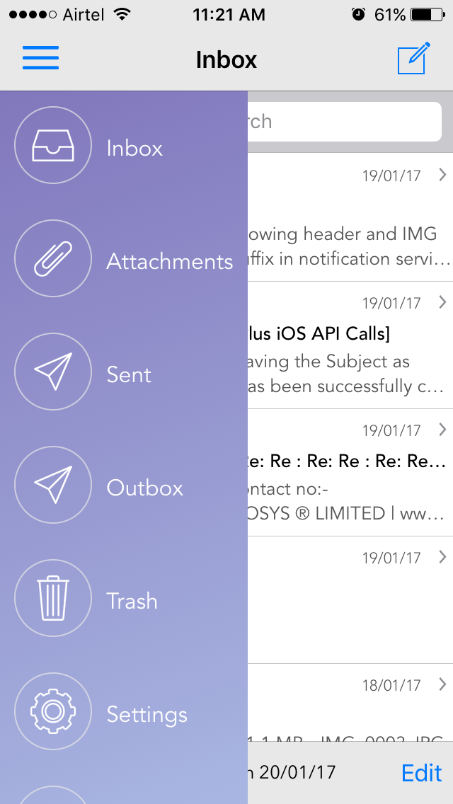
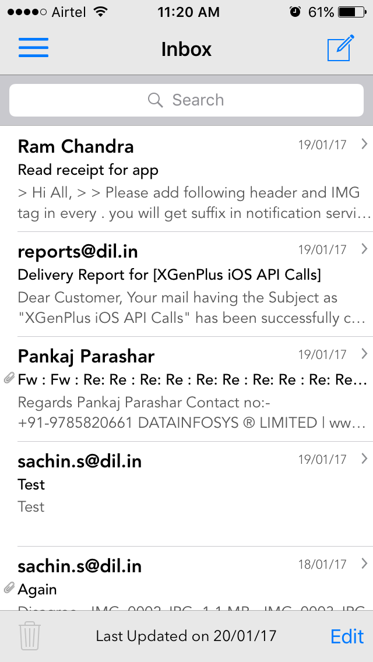
After Login User can check INBOX
User can check options through Side Menu

Slide 14
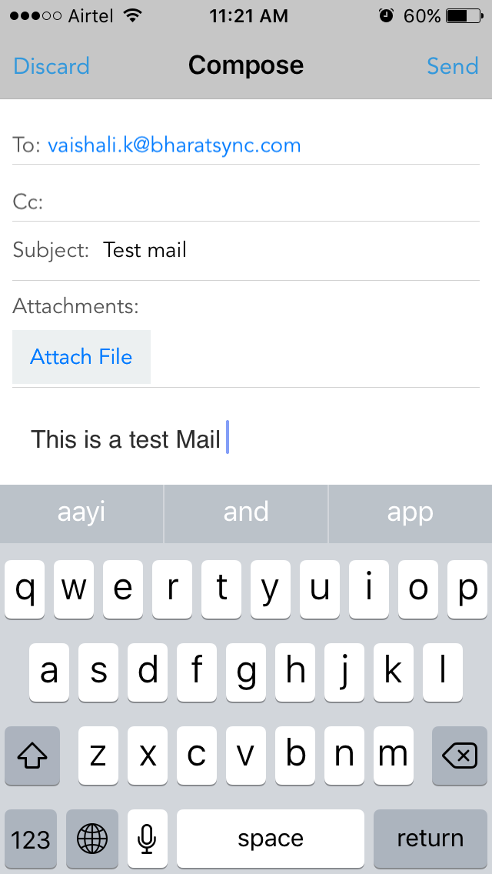
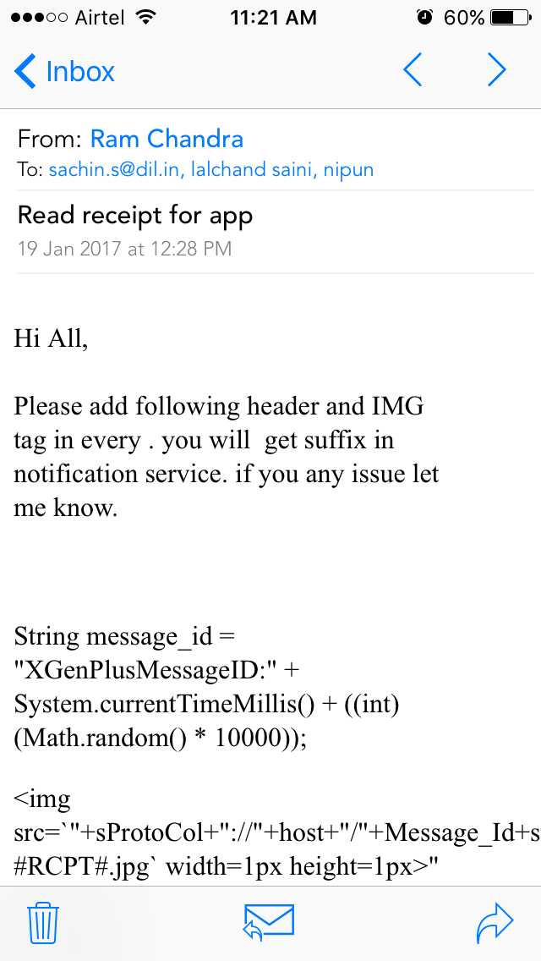
User can COMPOSE Email
User can read specific email

Slide 15
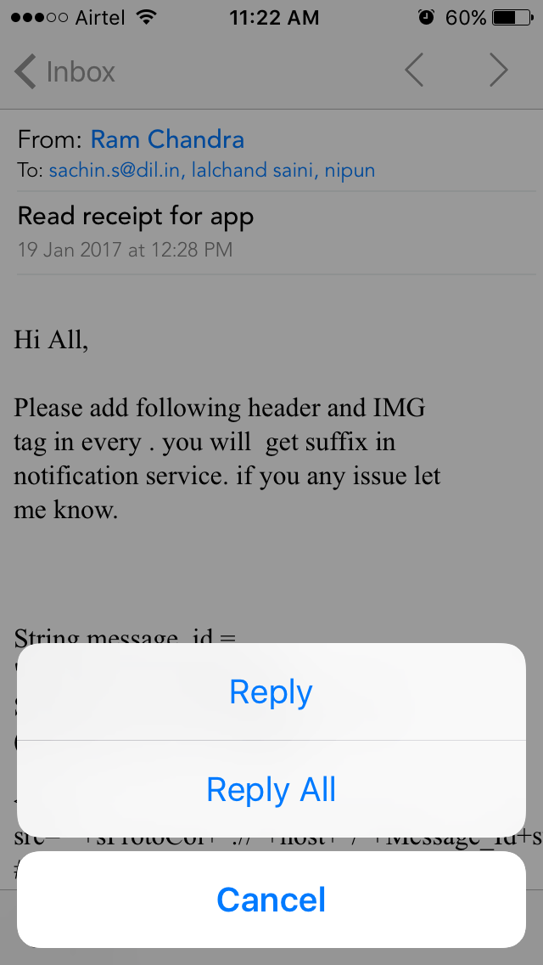
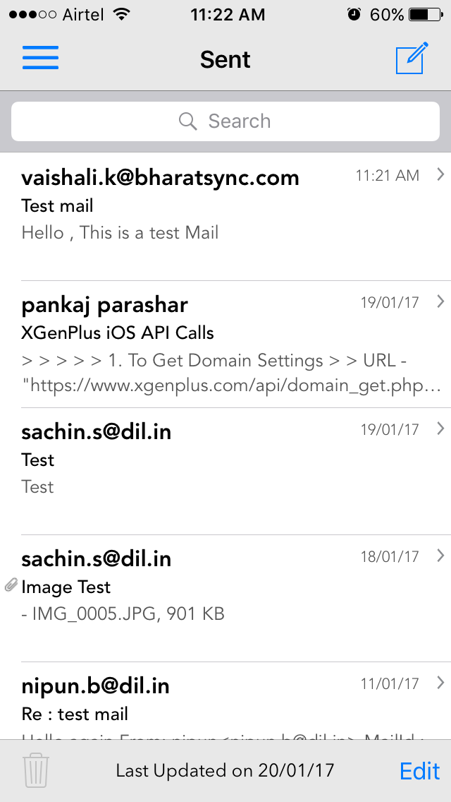
User can REPLY for specific Email
User can Check SENT EMails

Slide 16
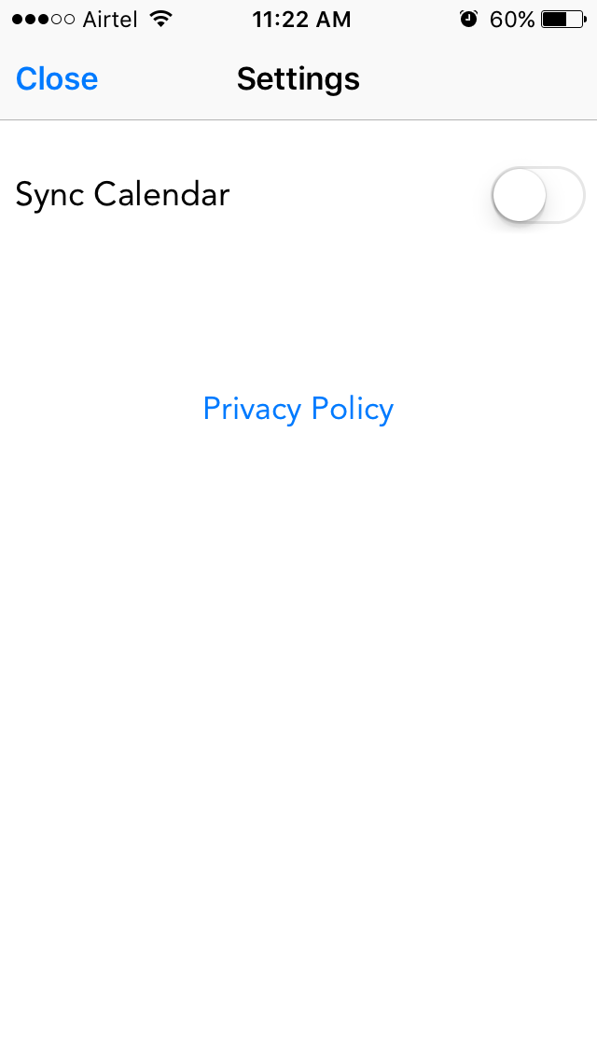

With Settings user can Sync Calendar with Application
With Settings user can Sync Calendar with Application

Slide 17
For More Details Please check Video of
iPhone APP
DOWNLOAD NOW

